Slide 1

Stress : Meaning and Defination
By
Alok Tiwari

Slide 2

Stress is a natural response to demanding or challenging situations that can impact an individual physically, mentally, and emotionally. It occurs when the body's stress response, triggered by perceived threats or pressures, becomes activated for extended periods. Stress can manifest as increased heart rate, tense muscles, difficulty concentrating, irritability, and anxiety.

Slide 3

Meaning
Stress is a physiological and psychological response to demanding or challenging circumstances. It is the body's way of reacting to perceived threats or pressures, whether they are real or imagined. When confronted with stressors, the body releases hormones like cortisol and adrenaline, triggering the "fight-or-flight" response. This response prepares the body to either confront the threat or escape from it.

Slide 4
Stress is a natural response to pressure and perceived threats.
It can be triggered by various factors like work, relationships, or major life changes.
Stress affects both the body and mind, leading to physical and emotional symptoms.
Prolonged stress can negatively impact overall well-being.
The body responds to stress through the "fight-or-flight" response.
Effective stress management techniques are essential for maintaining a healthy balance.
Self-care, relaxation techniques, and seeking support can help mitigate the effects of stress.

Slide 5
Defination
Here is a definition of stress presented in points:
Stress is a natural response to pressure or demanding circumstances.
It is the body's physiological and psychological reaction to perceived threats.
Stress can be triggered by various factors, such as work, relationships, or major life events.
It manifests as physical and emotional symptoms, such as headaches, muscle tension, anxiety, or irritability.
Prolonged or chronic stress can have negative effects on both mental and physical well-being.
The body responds to stress through the activation of the "fight-or-flight" response.
Effective stress management involves adopting healthy coping mechanisms like relaxation techniques, exercise, and seeking support.
Developing resilience and finding a balance in life is crucial in managing stress effectively.

Slide 6
STRESS MANAGEMENT
By
Aditya Upadhyay

Slide 7

Recognize the signs of stress, such as physical tension, irritability, difficulty concentrating, and changes in sleep patterns.
Identify the sources of stress in your life, whether they are work-related, relationship-based, or personal challenges.
Practice effective time management techniques to prioritize tasks and reduce the feeling of being overwhelmed.
Develop healthy coping mechanisms, such as deep breathing exercises, meditation, or engaging in hobbies you enjoy.
Maintain a balanced lifestyle by incorporating regular exercise into your routine, eating nutritious meals, and getting enough sleep.

Slide 8
Establish clear boundaries between work and personal life to prevent excessive stress from spilling over into other areas.
Seek social support from friends, family, or support groups to share your feelings and concerns.
Take regular breaks throughout the day to relax and recharge, rather than pushing yourself to the point of exhaustion.
Practice positive self-talk and challenge negative thoughts that contribute to stress.

Slide 9

Time Management
Set realistic goals and expectations for yourself, avoiding perfectionism.
Learn to say no when you feel overwhelmed or when taking on additional tasks would contribute to excessive stress.
Delegate tasks and responsibilities whenever possible to lighten your workload.
Practice effective communication skills to express your needs and concerns, avoiding bottling up emotions.
Avoid excessive caffeine, alcohol, and tobacco consumption, as they can exacerbate stress levels.

Slide 10

Individual Strategies
By
Vyom

Slide 11
WHAT IS INIDIVIDUAL STRATEGIES?
Individual strategies for stress management refer to specific actions and techniques that individuals can implement on their own to effectively cope with and reduce stress levels. These strategies focus on self-care, self-awareness, and self-regulation to help individuals better manage the impact of stress on their physical, mental, and emotional well-being. Here are some examples of individual strategies for stress management:

Slide 12
Health Related Strategies
Deep breathing techniques: Diaphragmatic breathing, box breathing, and alternate nostril breathing.
Meditation and mindfulness: Mindfulness-based stress reduction, guided meditation, body scan, and loving-kindness meditation.
Physical exercise: Aerobic exercises, strength training, yoga, Pilates, and dance.
Relaxation techniques: Progressive muscle relaxation, autogenic training, visualization, and guided imagery.
Time management: Prioritization, setting goals, task delegation, and effective scheduling.
Healthy eating habits: Balanced diet, portion control, mindful eating, and nutrition for stress reduction.
Sleep hygiene: Establishing a bedtime routine, creating a sleep-friendly environment, and practicing relaxation techniques before sleep.

Slide 13
Social Strategies
Assertiveness skills: Communication styles, expressing needs and boundaries, and conflict resolution.
Cognitive restructuring: Identifying and challenging negative thoughts, reframing perspectives, and cultivating positive self-talk.
Social support: Building a support network, seeking emotional connections, and joining support groups.
Hobbies and recreational activities: Engaging in activities that bring joy and relaxation, such as painting, gardening, playing an instrument, or engaging in sports.
Self-care practices: Taking breaks, practicing self-compassion, engaging in self-reflection, and setting aside personal time.
Emotional regulation: Identifying and managing emotions, stress journaling, and emotional expression.

Slide 14
SOME OTHER STRATEGIES
Technology and screen time management: Digital detox, setting boundaries, and establishing technology-free zones.
Financial management: Budgeting, debt management, and seeking professional advice for financial stress reduction.
Workplace stress management: Setting boundaries, effective communication, time management, and work-life balance.
Relaxing environments: Creating a calm and soothing space at home or work with appropriate lighting, scents, and décor.
Gratitude practice: Keeping a gratitude journal, expressing gratitude to others, and practicing gratitude meditation.
Stress-reducing hobbies: Engaging in activities such as gardening, cooking, knitting, or playing with pets.
Supportive self-talk and positive affirmations: Developing a repertoire of uplifting and encouraging statements to counter stress-inducing thoughts.

Slide 15

ORGANISATIONAL STRATEGIES
BY
KUWAR

Slide 16
What is organizational strategies?
Organizational strategies for stress management refer to actions and practices implemented within an organization or workplace to create a supportive and stress-reducing environment for employees. These strategies aim to address systemic stressors and promote a healthy work culture that fosters employee well-being and productivity. Here are some examples of organizational strategies for stress management:

Slide 17
Workload management: Ensuring reasonable workloads and workload distribution to prevent excessive stress and burnout among employees.
Clear communication and expectations: Providing clear job descriptions, expectations, and guidelines to reduce ambiguity and promote efficiency.
Flexibility and work-life balance: Implementing flexible work arrangements, such as remote work options or flexible scheduling, to support employees' personal needs and responsibilities.
Employee involvement and participation: Encouraging employee input, involvement in decision-making processes, and seeking feedback to enhance job satisfaction and reduce stress related to lack of control.

Slide 18
Training and skill development: Providing relevant training and development opportunities to equip employees with necessary skills and resources for their roles, reducing stress caused by inadequate training or support.
Supportive leadership: Promoting a leadership style that emphasizes empathy, support, and open communication, fostering a positive work environment and reducing stress related to poor leadership.
Recognition and rewards: Implementing recognition programs to acknowledge and reward employees' achievements and contributions, boosting morale and reducing stress.
Workplace wellness initiatives: Offering wellness programs and initiatives, such as stress management workshops, mindfulness training, or physical fitness activities, to support employees' overall well-being.

Slide 19
Encouraging breaks and downtime: Promoting a culture that values and encourages regular breaks, vacations, and time off to recharge and prevent burnout.
Conflict resolution mechanisms: Establishing effective conflict resolution procedures and resources, such as mediation or counseling services, to address workplace conflicts promptly and reduce stress.
Open communication channels: Creating a culture that encourages open and honest communication among employees and between employees and management, facilitating the expression of concerns and reducing stress from unresolved issues.
Support for work transitions: Providing support and resources for employees during significant organizational changes, such as restructuring or mergers, to minimize stress and facilitate smooth transitions.
Employee assistance programs (EAPs): Offering confidential counseling services or EAPs to provide employees with professional support and guidance for personal or work-related stressors.

Slide 20

EMPLOYEE COUNSELLING
BY
MANISH

Slide 21
What is emplyee counselling?
Employee counseling, also known as employee assistance programs (EAPs) or workplace counseling, is a confidential and professional support service provided by organizations to assist employees in addressing personal, emotional, or work-related challenges that may impact their well-being and performance. Employee counseling aims to provide a safe space for employees to discuss their concerns, explore potential solutions, and receive guidance from trained professionals. Here are some subtopics that further explain the components and aspects of employee counseling:

Slide 22
Confidentiality: Emphasizing the confidential nature of employee counseling, assuring employees that their discussions and personal information will be kept private and separate from their work records.
Assessment and triage: Conducting an initial assessment to understand the employee's needs and determine the appropriate level of support or referral, ensuring they receive the most suitable assistance.
Counseling sessions: Providing one-on-one counseling sessions between the employee and a qualified counselor or therapist to discuss their concerns, emotions, and challenges in a safe and supportive environment.
Mental health support: Addressing mental health issues such as stress, anxiety, depression, or grief, and providing strategies and interventions to manage and overcome these challenges.
Work-related issues: Assisting employees in navigating work-related stressors, conflicts, or challenges, including job dissatisfaction, work-life balance, or career development.

Slide 23
Referrals and resources: Offering information and referrals to external resources and specialists, such as mental health professionals, financial advisors, or legal services, based on the employee's specific needs.
Crisis intervention: Providing immediate support and intervention in critical situations, such as traumatic incidents or emergencies that may impact the employee's well-being or ability to function at work.
Workshops and training: Conducting workshops, seminars, or training sessions on topics related to mental health, stress management, communication skills, or resilience to enhance employees' well-being and coping strategies.
Conflict resolution: Assisting employees in managing and resolving conflicts within the workplace, providing guidance on effective communication, negotiation, and problem-solving techniques.
Work-life balance: Supporting employees in achieving a healthy work-life balance by exploring strategies to manage time, set boundaries, and prioritize self-care.

Slide 24
Substance abuse and addiction support: Addressing substance abuse issues and providing information, resources, and referral options for employees struggling with addiction.
Return-to-work support: Assisting employees in transitioning back to work after a medical or personal leave, providing support, accommodations, or gradual reintegration plans, if needed.
Managerial and supervisory consultations: Offering guidance and support to managers and supervisors in effectively supporting their team members' well-being, recognizing signs of distress, and addressing employee concerns.
Wellness and preventative programs: Collaborating with other departments or specialists to develop and implement wellness programs, activities, or initiatives aimed at promoting overall employee well-being and preventing stress-related issues.
Evaluation and feedback: Collecting feedback and conducting evaluations to assess the effectiveness and impact of employee counseling services, making necessary improvements to better support employees' needs.

Slide 25
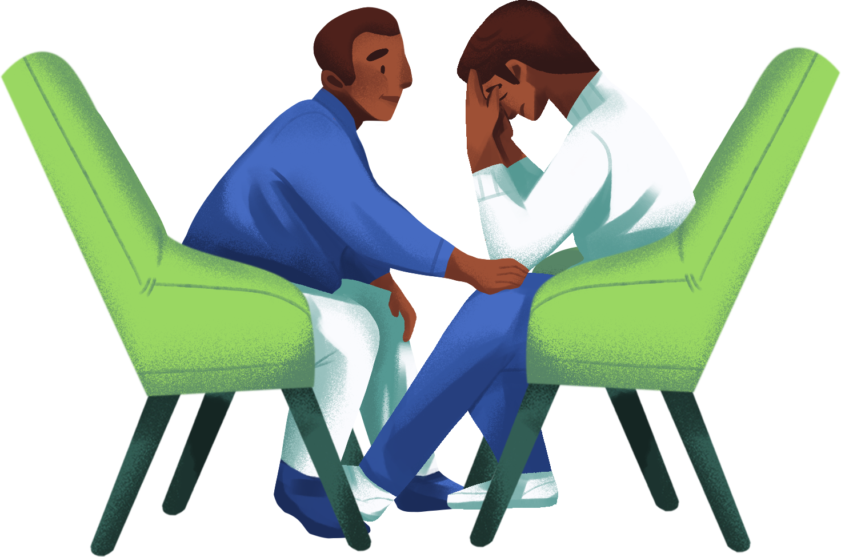
EFFECTS OF STRESS
BY
HIMANSHU KUMAR PANDEY

Slide 26
Physical health effects:
a. Increased risk of cardiovascular problems, such as high blood pressure, heart disease, and stroke.
b. Weakened immune system, leading to frequent illnesses and infections.
c. Digestive issues, including stomachaches, indigestion, and irritable bowel syndrome.
d. Sleep disturbances, such as insomnia or disrupted sleep patterns.
e. Muscle tension, headaches, and migraines.
f. Impact on reproductive health, including menstrual irregularities or decreased libido.

Slide 27
Mental health effects:
a. Increased risk of anxiety disorders, including generalized anxiety disorder, panic disorder, or social anxiety.
b. Development or exacerbation of depressive symptoms and major depressive disorder.
c. Higher likelihood of experiencing burnout, chronic fatigue, or emotional exhaustion.
d. Impaired cognitive functioning, including difficulties with memory, concentration, and decision-making.
e. Increased vulnerability to developing or worsening substance abuse problems.
f. Higher risk of developing or exacerbating existing mental health conditions, such as post-traumatic stress disorder (PTSD) or obsessive-compulsive disorder (OCD).

Slide 28
Emotional effects:
a. Heightened levels of irritability, frustration, or anger.
b. Mood swings, emotional instability, or increased vulnerability to emotional distress. c. Feelings of overwhelm, helplessness, or being unable to cope with challenges.
d. Increased risk of experiencing persistent feelings of sadness, hopelessness, or worthlessness.
e. Decreased self-esteem or self-confidence.

Slide 29
Long-term health implications
a. Chronic stress can contribute to the development or exacerbation of chronic conditions, such as diabetes, asthma, or autoimmune disorders.
b. Increased risk of developing mental health disorders or chronic psychological conditions.
c. Accelerated aging process at the cellular level, potentially leading to premature aging and related health issues.
d. Impact on longevity and overall quality of life.

Slide 30


